Slide 1
Physical computing from Scratch using scratchClient – Beginners Control servos, LEDs and more from Scratch using RPi, Arduino, scratchClient
Hans de Jong & Gerhard Hepp
Pi And More 10 1/2
Stuttgart – 24 February 2018

Slide 2
Part 1: Introduction

Slide 3
When you look at this at home …
If the presentation is messed up …
You need the Calibri font on your Raspberry Pi (standard on Windows but not on Raspberry Pi).
Hence look at the .pdf version which does not need the font to be installed.

Slide 4
Workshop organisation
The major steps:
Get a working hardware and scratchClient config using a scratchClient config tool.
Put components on the board and test out your setup.
Write some code in Scratch
Add more hardware and update the config file.
And repeat this.
Welcome and introduction presentation (5 min).
After that everyone will work at his or her own pace.
Choose with your “workplace partner” which topics you want to do.
There is more material than what can be covered in 110 minutes.
Language: Both German and English
At the end copy the material you created to your USB stick (if you want)
Break down & clean up (5 min)

Slide 5
Objectives
At the end of today you should be able to do a few of these items:
Reproduce the setup at home (provided you have the hardware ☺ )
You can get all files via https://github.com/hansdejongehv/Weekendschool-PiAndMore
Or go to www.github.com and search for piandmore
Understand (depending on how far you get and how deep you dive in)
Digital output (e.g. lighting a LED)
Digital input (e.g. sensing a button)
Analog input (e.g. from a potentiometer)
Pulse Width Modulation (PWM)
For dimming LEDs
For controlling servos
For sounding a buzzer
Understand what all the resistors are for
Be able to configure and run scratchClient
Program Scratch to control the physical input and output
Monitoring the inputs and outputs
Have fun!

Slide 6
Non-objective
It is not an objective to create a complete useful game or other program.
You can do that with your own creativity at home now that you know how to control several pieces of hardware from Scratch using scratchClient.

Slide 7
Example of what can be created with Scratch and scratchClient
https://www.youtube.com/watch?v=Qo1gnXNzhqE

Slide 8
Versions of Scratch
scratchClient can work with
Scratch 1.4
The (for Raspberry Pi) new Scratch 2
This workshop is written for Scratch 2
Scratch 2 on Raspberry Pi has some bugs, but we will work around it.
If you want to see how to do it for Scratch 1.4, see the end of the presentation in Appendix A.

Slide 9
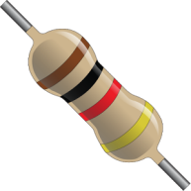
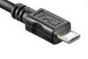
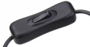

Only a few rules today
Always put a resistor in series with the components when indicated.
If you think there is no need then please tell us and we will explain what the reason is.
When changing the wiring
Detach the USB cable from the Arduino Nano
Switch off the 9V power
Check, double check and check again whether the wiring is correct. You may blow up components when wiring wrongly!
Make sure that you both (4 eyes principle) are convinced the wiring is OK before reconnecting and turning on power again.
After changing a config file: restart scratchClient
If something breaks down or gets damaged: we have some spare material
Do not put anything that is broken back into the box please.

Slide 10
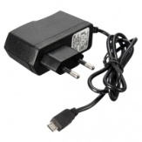
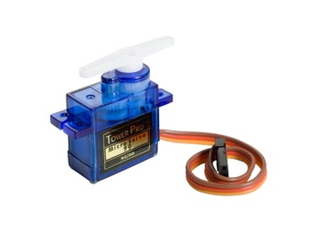
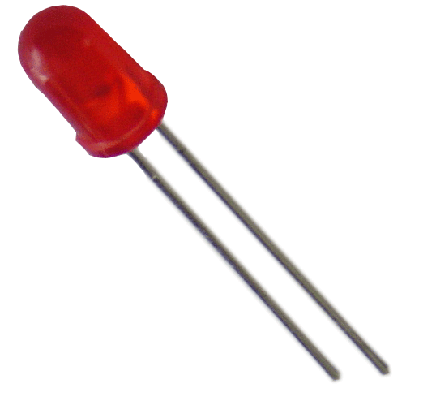
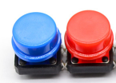


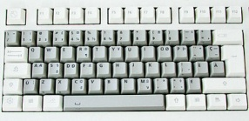
The setup
Raspberry Pi 3B .
Arduino Nano
Scratch 2 run time
Scratch 2 extension for scratchClient
scratchClient
scratchClient Sketch
Program in Scratch
Predefined sprites (with some code, sounds and costumes)
scratchClient Config file
Defines function of the GPIO pins on the Arduino (and RPi) and gives them logical names.
Standard setup
Programmed by the students (today: you)
Prepared by the teacher or expert (today: you)

Slide 11
Choose what you want to do
Workshop is for everyone, from beginners to experts.
Not enough time to do all, so choose what you want to do.
Yellow slides have background information and you can skip them if you want or look at it later
Recommended
All: learn to configure scratchClient by doing LEDs (digital out) and Button (digital in)
All: try it out in Scratch
After that: select further topics from separate files
Intermediate level
Advanced level (material in English only)
Expert level (material in English only)

Slide 12
Part 2: Getting to know the components

Slide 13
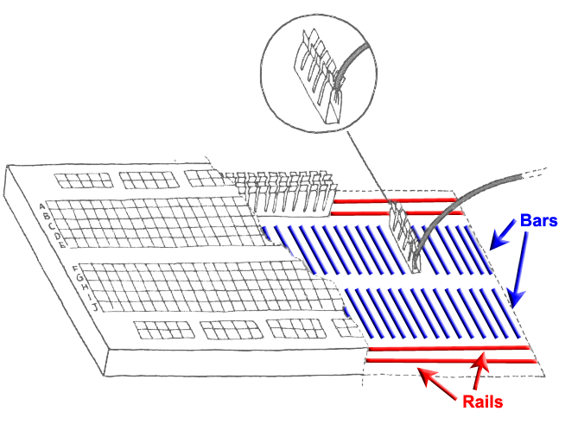
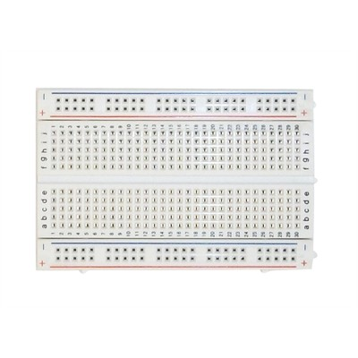
Breadboard
Used to quickly build electronic circuits
Note the 2 rails for + (VCC) and – (GND)
Note on every column (vertical) the 2 bars with 5 interconnected holes each.

Slide 14
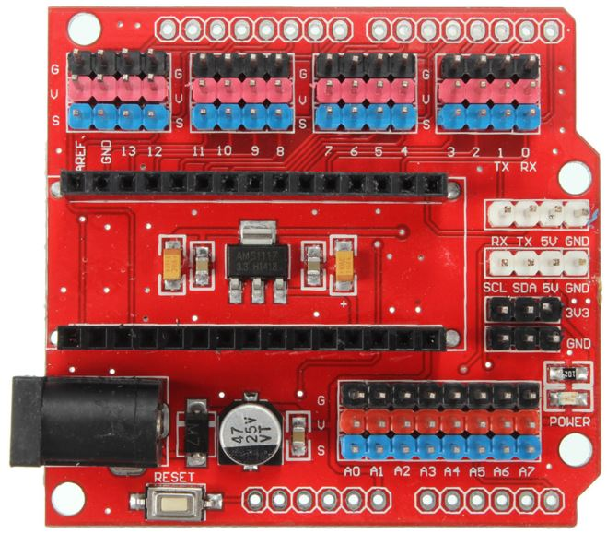
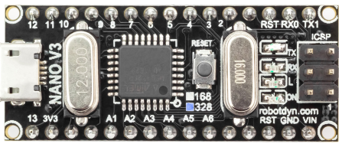
Looking at the Arduino Nano extension board
Analog ports (most can be used as digital ports as well)
Reset button
Per GPIO signal 3 headers:
S (blue = signal)
V (red = VCC = +)
G (black = GND = -)
(very handy to e.g.
connect servos)
9V power socket
Arduino Nano with 328P processor
Micro USB port
Reset button
Digital ports

Slide 15
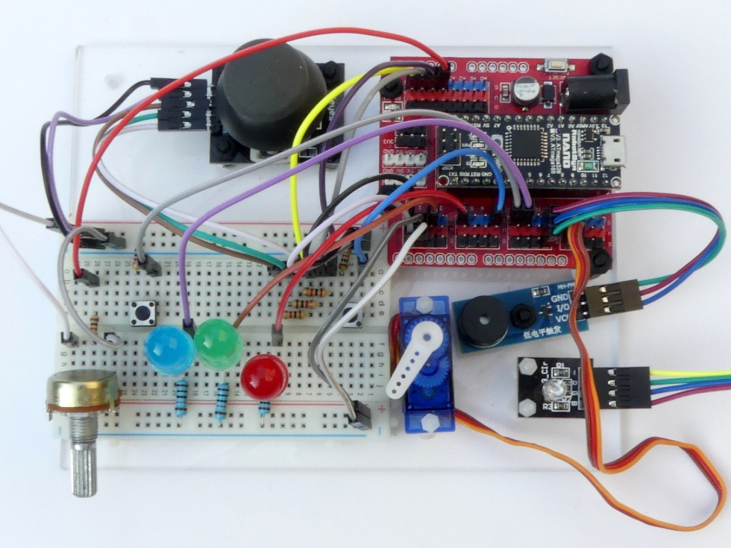
What the final board looks like …
Other picture to be made
… at the end of the basic level

Slide 16
… at the end of the intermediate level …

Slide 17
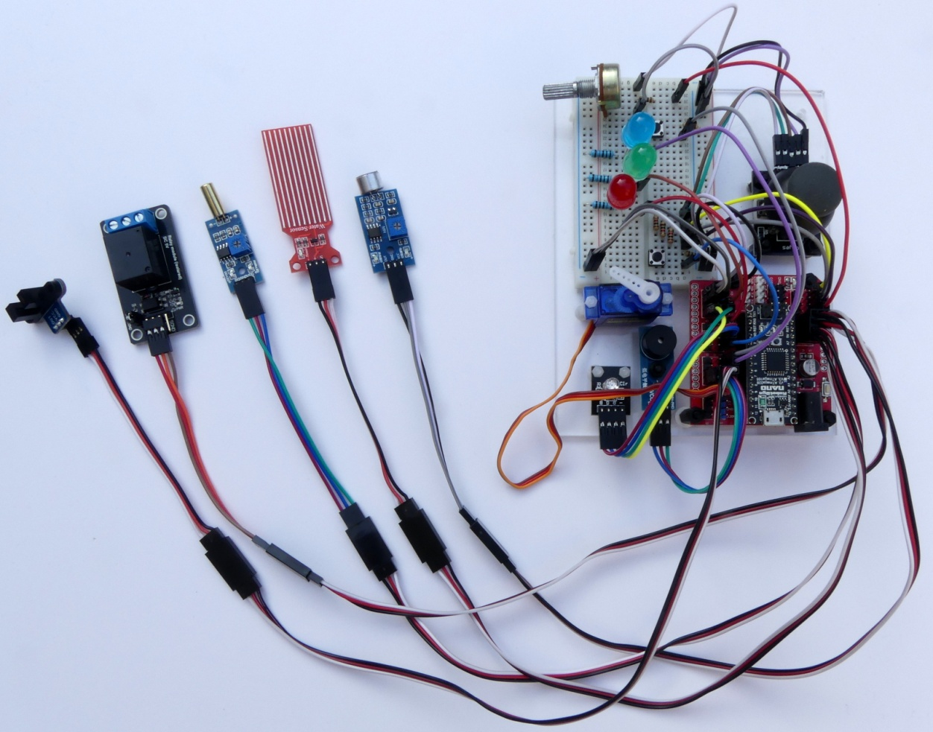
… and at the end of the advanced level

Slide 18
Part 3: Loading the sketch in the Arduino (optional)

Slide 19
Preparing for programming the Arduino Nano
The Arduino needs to run a program (in Arduino terms: sketch) so that it can communicate with the Raspberry Pi and understand the messages from scratchClient.
We need to start putting that in.
However that has already been done, so you can skip the next slide, unless you want to try for yourself.

Slide 20
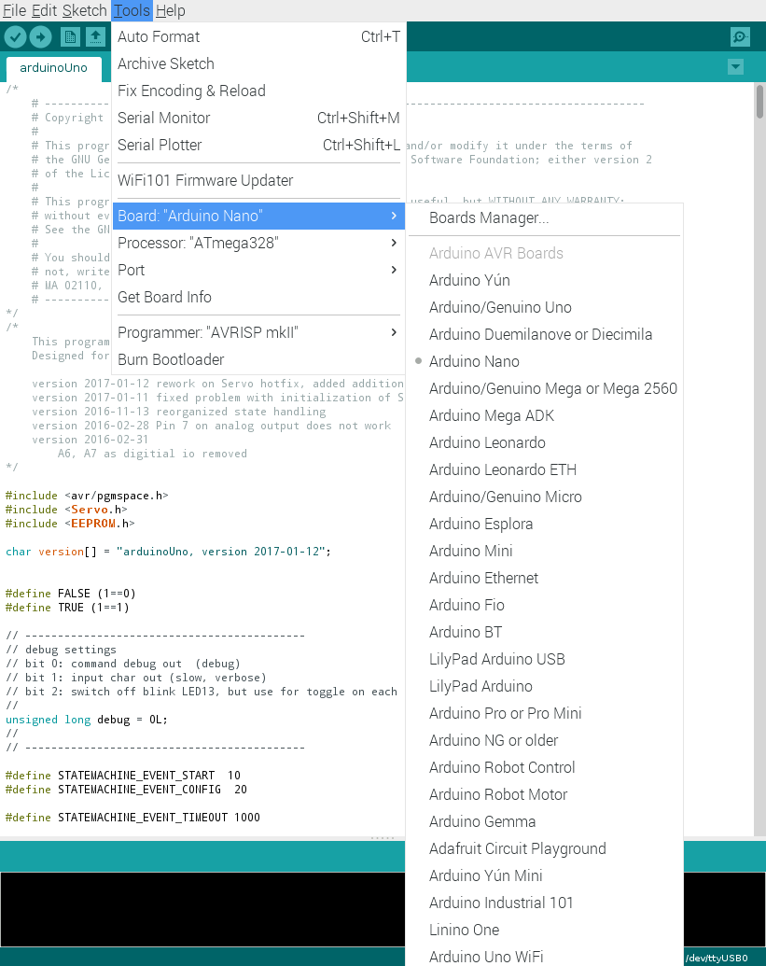
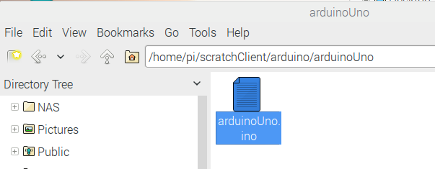
Uploading scratchClient to the Arduino
Navigate to the scratchClient sketch for Arduino Uno in /home/pi/scratchClient/arduino/arduinoUno
Double click to open the Arduino IDE
Click Tools and make sure that these are set:
Board: Aruino Nano
Processor Atmega328
Port: the port where the Arduino Nano is connected (normally /dev/ttyUSB0)
Click on the Upload button.
Wait till the completion of the Upload is reported (without errors).

Slide 21
Part 4: Defining the configuration
Give names to pins and define the purpose of the pin

Slide 22
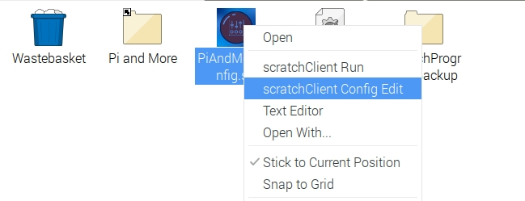
Starting the config tool
New screenshot needed when icon is fixed.
We have put an empty config file on the desktop:
PiAndMoreConfig.scl
Right click the file and choose scratchClient Config Edit

Slide 23
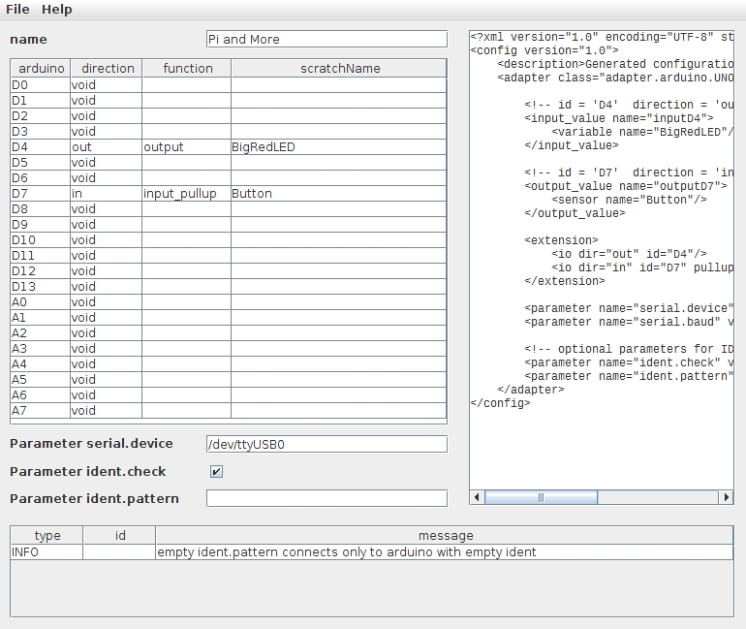
Define the first config file
See below. Is check for blanks and dashes actually done?
D4
Direction: out
Function: output
scratchName: BigRedLED
Double click a cell to get a drop down menu
First for direction then for function.
Make sure to give all pins a name if you choose something else than void in direction.
So make sure not to save if you still have red borders around cells. scratchClient will fail to start with such a config file.
The tool checks wrong configurations. Examples:
Blanks or dashes in scratchNames
Pins 0, 1 and 13 cannot be used at all
Analog in only available on A0 to A7
Pins A6 and A7 can only be used for analog in
Pins 9 and 10 cannot be used for PWM if any pin is configured for servo (see later)
D7
Direction: in
Function: input_pullup
scratchName: Button
Parameter serial.device: /dev/ttyUSB0

Slide 24
Save the config file
Adapt if scratchClientConfig has been updated to remember the pathname as argument. Then the two first lines just become: Save
Save the file on the desktop
On the first save, click PiAndMoreConfig.scl
Leave the tool open for the next exercises.

Slide 25
Part 5: Wiring the board and run the first setup

Slide 26
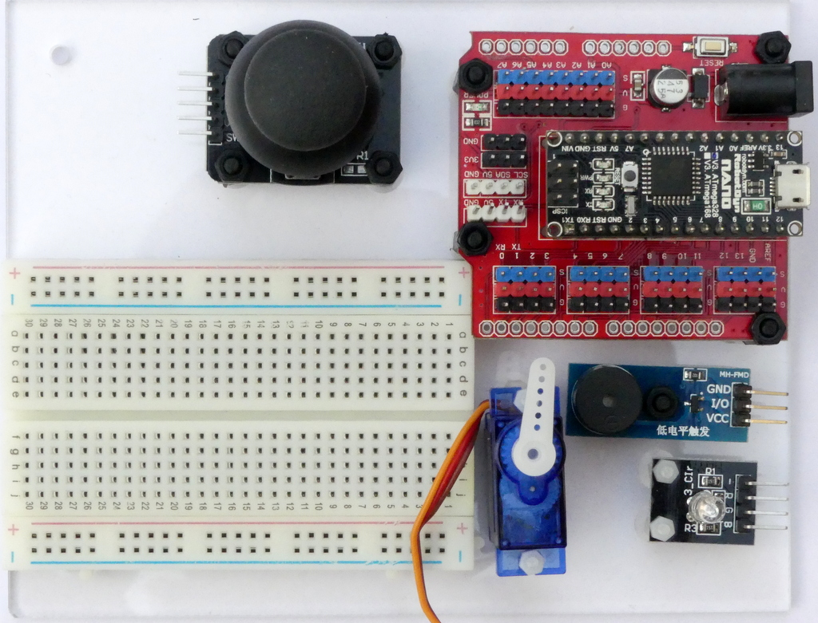
Put the board in front of you in this way

Slide 27
Use short wires and use the indicated holes
There are some short wires (10 cm) and some longer (15 cm)
Use the shortest that you can
Get a less messy setup
You may otherwise run out of long wires later
Ignore wire colors.
You can in principle build up at different places on the breadboard, however …
… please use the indicated columns to avoid running out of space on the breadboard in the later part of the workshop.

Slide 28
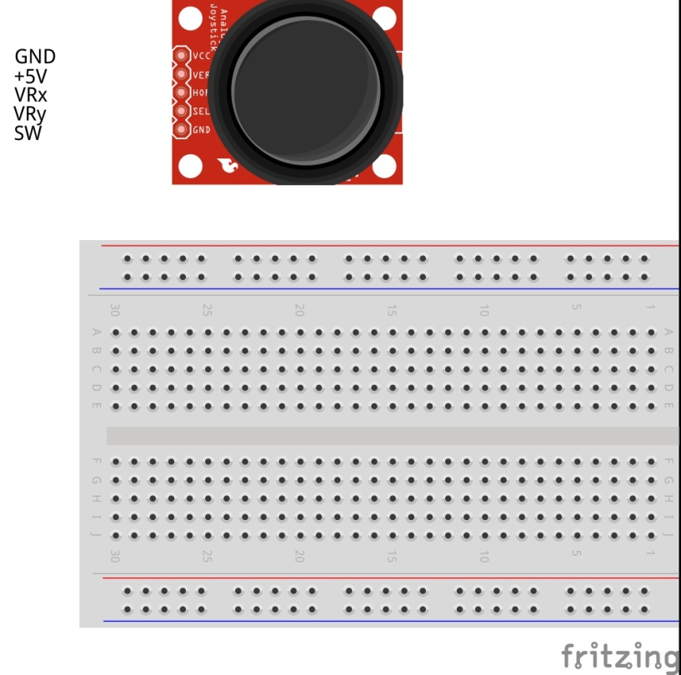
Connect the power wires

Slide 29
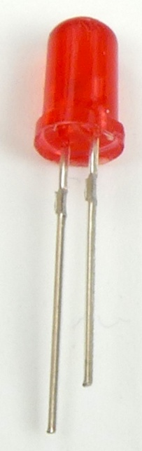
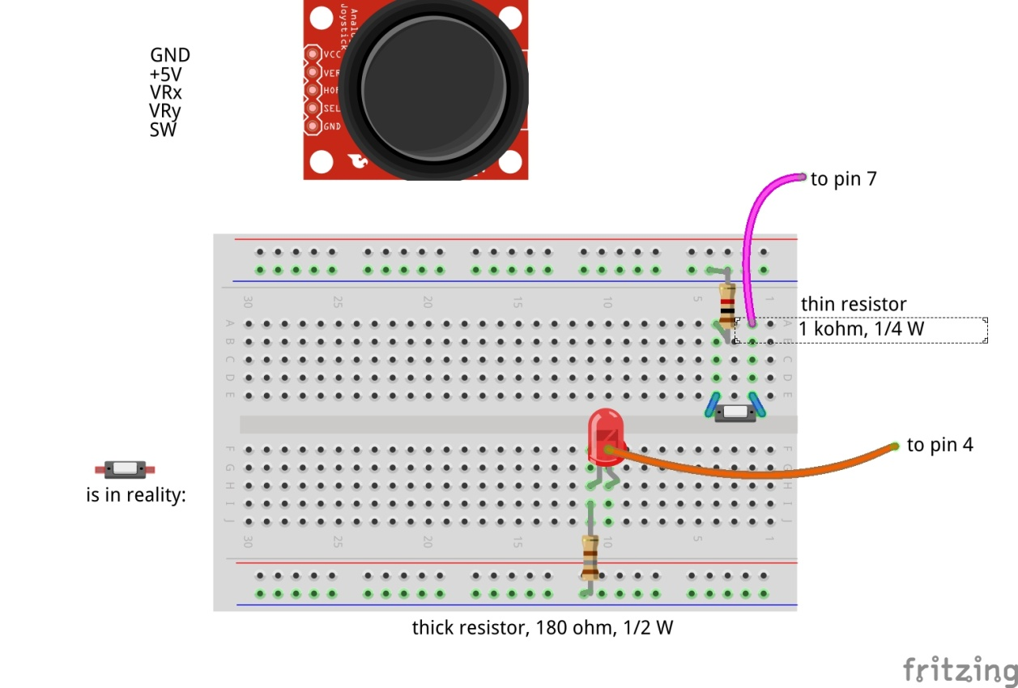
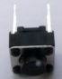
Insert the red LED and button
Long wire = plus (+) side
Short wire = minus (-) side
Notes:
The LED has polarity. The long wire is the + side, the short wire is minus. You must connect LEDs such that the minus side of the LED is closest to the minus on the board and the plus side is of the LED is closest to the plus on the board – which is for this LED provided by the Arduino pin.

Slide 30
Why putting a resistor in series with the LED?
+5 Volt
Arduino
Digital output
The LED
This resistor is for limiting the current through the diode
(you will blow up the LED and/or the Arduino otherwise)
+
-
180 Ohm resistor (the thick ones in the box)
0 Volt

Slide 31
What does Arduino need on a Digital Input pin?
A digital input pin of Arduino needs to get either
0 volt input (actually, 0 to 1.5 volt is considered a LOW input signal)
5 volt input (actually, 2.5 volt to 5 volt is considered a HIGH input signal)
If it gets something between 1.5 volt and 2.5 volt, the interpretation will not be stable (could be LOW or HIGH).
If it does not get any signal in, then the interpretation of the signal is not stable (could be LOW or HIGH).

Slide 32
Producing a LOW value
+5 Volt
Arduino
Digital input
The button
If the button is closed, the digital input signal is set to 0 volt which is detected as LOW.
0 Volt
But what will the Arduino detect if the button is open?
32

Slide 33
Producing a HIGH value
+5 Volt
If the button is pressed, then it connects the input of the Arduino to 0 volt. There will run a small current through the resistor, but the input will be 0 volt.
If the button is open, the resistor will pull up the input to 5 volt. A very small current will flow through the resistor, but is small enough that the voltage on the digital input will be very close to 5 volt = HIGH.
Arduino
30
kOhm
This is a pull-up resistor that provides 5 Volt if the button is opened
Digital input
0 Volt
33

Slide 34
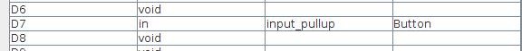
Producing a HIGH value without external resistor
+5 Volt
Arduino
You do however not have to connect the resistor externally. It can be configured in the Arduino itself by specifying input_pullup rather than input.
Digital input
30 kOhm
0 Volt
34

Slide 35
Danger when misconfiguring
+5 Volt
Arduino
This works fine, but what happens if you misconfigure the pin to be Digital Output, the value set to HIGH and the button is pressed?
If the Arduino makes the pin HIGH (5 volt) and the button connects to LOW (0 volt) → short circuit and the Arduino will be blown up.
Digital input
30 kOhm
0 Volt
35

Slide 36
Resistor in series to prevent damage in case of misconfiguration
+5 Volt
Arduino
Therefore always include a 1 kOhm resistor in series with the switch.
If misconfigured, there will run a small current through the resistor rather than causing a short circuit.
The input will be 1 kOhm / (30 kOhm + 1 kOhm) * 5 volt = 0,15 volt.
See appendix B for more info.
Digital input
30 kOhm
1 kOhm
0 Volt
36

Slide 37
Check / double check
Please now check both of you that the wiring is correct.

Slide 38
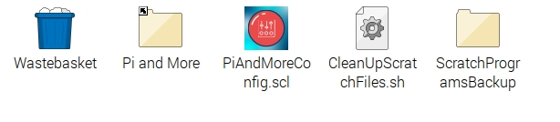
Bringing things together
Connect the 9 Volt connector to the board and switch power on
Connect the USB connector to the Arduino
Doubleclick PiAndMoreConfig.scl on the desktop to start scratchClient with the config file you have just updated
It will also open a browser window where you can see variables
Explained later in the presentation
In the terminal window you will see complaints that scratchClient has no connection to Scratch
Which is logical because Scratch was not started yet.

Slide 39
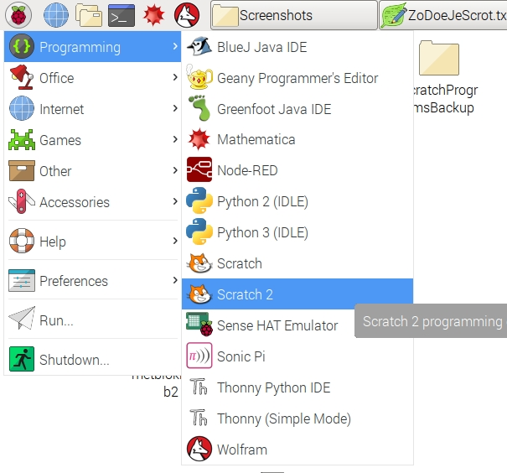
Start Scratch 2

Slide 40
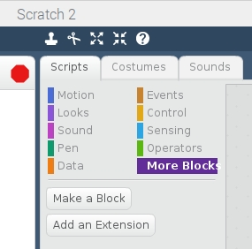
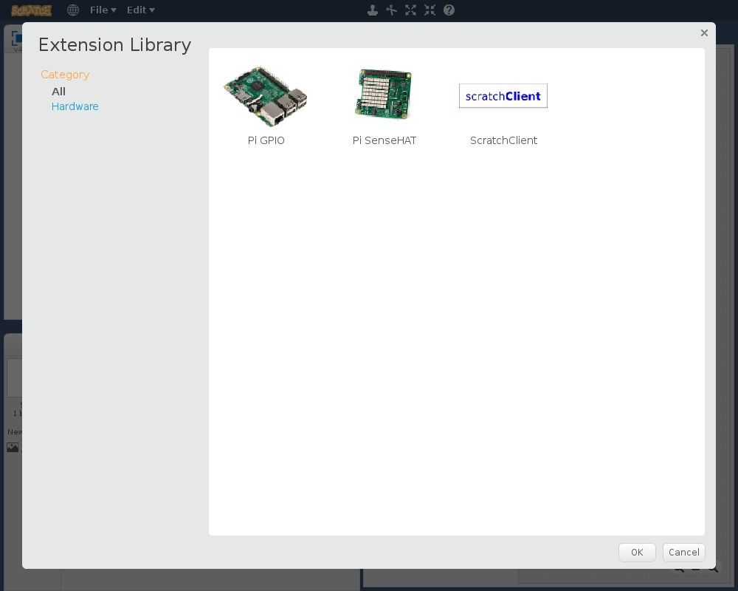
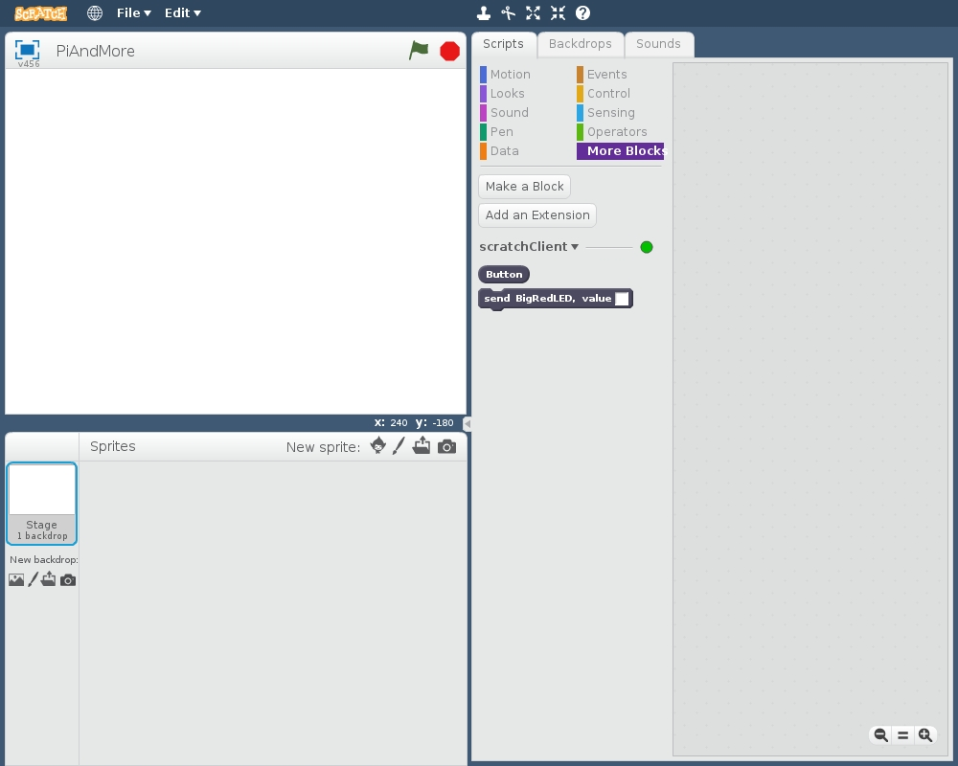
Start Scratch 2 and get scratchClient blocks
Click on More Blocks
Clidk on Add an Extension
Choose scratchClient
Now the extra blocks of scratchClient get included.
One block is added for each defined pin in the config file
Wait 10 seconds and look whether the blue LED on the Arduino Nano blinks slowly instead of fast. If so, the connection is established.

Slide 41
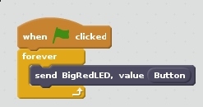
Create the Scratch program
Create this program in Scratch and try it out (click the set of blocks or click the green flag above the animation window).
Digital in (Button):
0 = pressed
1 = not pressed
Digital out (LED)
0 = off
1 = on
Analyse how the program works.

Slide 42
Does it work? (see next slide for help)
If the LED on the Arduino is blinking slowly only then the config is downloaded and scratchClient works.
It may take 10 seconds after both scratchClient and the scratchClient extensions in Scratch 2 are loaded before this happens.

Slide 43
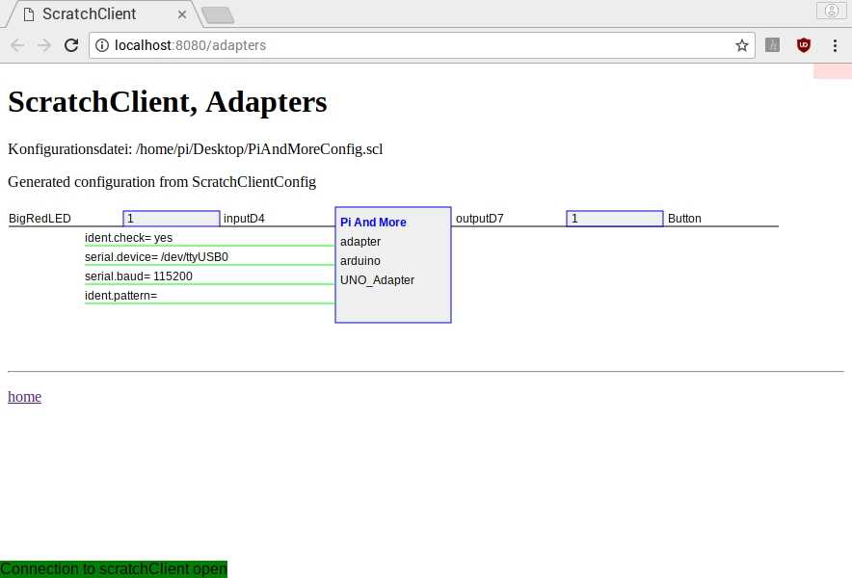
You can monitor the values that are exchanged
Together with scratchClient, the browser is opened with URL localhost:8080/adapters
Note the input & output directions:
Output of an adapter is an input for scratch
Output of scratch is an input for the adapters.
Hence the names input and output look to be reversed from what is in the config file.
Therefore best refer to the variable names.
You will see that values are only displayed after they have changed (otherwise a question mark (?) is displayed).
Not for now, but you can click the field and type a value which then will be sent in the appropriate direction.

Slide 44
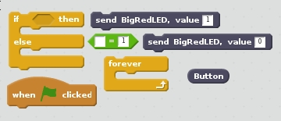
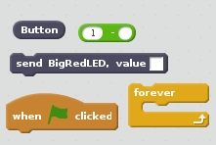
Change the program
Make a change in the program so that the LED goes on when the button is pressed.
There are (at least) two ways
You need the blocks depicted here
Blocks for method 1
Blocks for method 2

Slide 45
What if it does not work?
Check whether you have multiple Scratch instances open
scratchClient can only work with one Scratch at a time (regardless of being Scratch 1.4 or Scratch 2).
Check if the blue LED on the Arduino Nano is blinking slowly.
Sometimes, especially after reboot, if everything seems fine, disconnecting and reconnecting the Arduino Nano may help.
Try monitoring the variables, see before.

Slide 46
One reminder …
Save your Scratch program regularly. Otherwise it will be lost on power out.
Power out can easily happen since you are pulling cables and may impact the power connector in the Raspberry Pi.
Here come some current Scratch 2 anomalies on RPi
You should not use spaces in filenames (if you do, they will be removed)
Scratch 2 forgets the folder where the file was opened from (Desktop). Just save it in /home/pi as Scratch proposes
Scratch 2 will save it with a .sbx extension regardless what you specify.
Hence once after power up
On the desktop, doubleclick CleanUpScratchFiles.sh
You can minimize the window, but let it run forever
This will permanently monitor the folder /home/pi, and
Move all files with .sbx to the desktop as .sb2 files
Any spaces in filenames are removed
If there is already such a file on the desktop, it will be moved to the folder ScratchProgramsBackup on the desktop

Slide 47
Part 6: Adding the Big Green LED

Slide 48

Adding the green LED

Slide 49
Check and reconnect
Check the correct wiring
Switch on the 9V power
Connect the USB cable again

Slide 50
Update the config file and restart scratchClient
Use the config tool (which should still be open)
Define an output (direction: out, function: output) on pin 2 and call it BigGreenLED
Save the config file (and leave the tool still open)
Doubleclick PiAndMoreConfig.scl on the desktop again
This will stop the previous instance of scratchClient and restart with the updated configuration.
Save the scratch file, and reopen it. Note, it may appear at another place then where it was.
You will see the new block for BigGreenLed in the More Blocks section

Slide 51
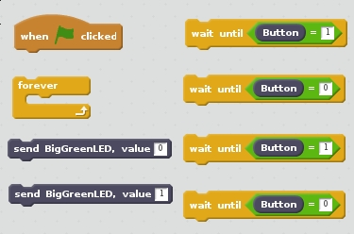
Update Scratch
Add code that does this:
Press button: LED goes on
Press once more: LED goes off
You need these program elements.

Slide 52
This is the end of the beginners level
You got digital out (LED) and digital in (a button) working
You know how to work with scratchClient and Scratch 2
You know how to configure scratchClient
If you want and have time you can
Look at some of the yellow slides if you skipped them earlier
Continue with one of the next levels
These are in different files.
Otherwise,
you can, if you want, copy the files from the desktop to your USB stick
Unplug one of the mice to get a free USB connector
Cleanup
Please shutdown the Raspberry Pi
Tear down the setup and put all components in the box

Slide 53
Overview of next levels
Intermediate level
Analog in: Potentiometer
Pulse Width Modulation (in the absence of analog out)
Dimming a LED
Controlling a servo
Controlling a buzzer
Advanced level
Expert level

Slide 54
Part 10: Take your work home

Slide 55
Do you want to take your work home?
If you brought your own USB stick, then connect it and copy the PiAndMoreConfig.scl file on the desktop, plus all .sb2 files that you created on the desktop
The rest of the material you can download from www.github.com, search for PiAndMore
Take the flyer with you to remember where to find the material on github.

Slide 56
Appendix A When using Scratch 1.4

Slide 57
The setup
Raspberry Pi
2B or 3B
Arduino Nano
Scratch 1.4 run time
scratchClient
scratchClient Sketch
Remote Sensor Protocol Over socket 42001
Global variables
Broadcasts
Program in Scratch
Predefined sprites (with some code, sounds and costumes)
scratchClient Config file
Defines function of the GPIO pins on the Arduino (and RPi) and gives them logical names.
Standard setup
Programmed by the students
Prepared by the teacher or expert

Slide 58
Defining the config file
Nothing new, you can use the exact same config file for Scratch 1.4 as for Scratch 2.

Slide 59
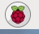
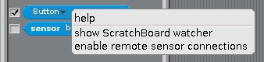
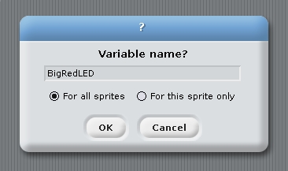
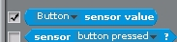
Create the Scratch program
Start Scratch → Programming → Scratch
Enable remote connections (right click on sensor value)
Create the variable BigRedLED, available to all sprites
Make the variable visible (tick the box in front)
Make the Button sensor visible
Save the file on the desktop.

Slide 60
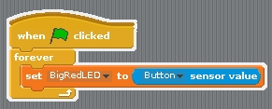
Program in Scratch 1.4
Make a program in scratch which will let the Red LED lite up when the button is pressed.
You need these elements.

Slide 61
Appendix B Basic Electronics

Slide 62
End of the beginners workshop

Slide 63
Physical computing from Scratch using scratchClient – Intermediate Control servos, LEDs and more from Scratch using RPi, Arduino, scratchClient
Hans de Jong & Gerhard Hepp
Pi And More 10 1/2
Stuttgart – 24 February 2017

Slide 64
Part 7: Adding analog input

Slide 65
Changing the wiring on the board
When changing the wiring on the board
First pull the USB cable out
Switch off the 9V supply

Slide 66
The electronics of a potentiometer
The potmeter is a resistor that will be connected between 5 V and 0 V.
Over the length of the resistor the voltage drops linearly.
E.g. in the middle it would be 2.5 Volt
So this is an analog signal. The value can be changed between 5 V and 0 V.
There is a 1 kOhm resistor in series for the reasons discussed earlier
+5 Volt
Consider what would happen if the 1 kOhm resistor were not there and the port would be used as output and potmeter positioned close to the 0 Volt side.
Then the Arduino would output 5 Volt, and the potmeter is directly leading it to the 0 Volt line → short circuit!
Arduino
1 kOhm
Potentiometer
Analog input
10 kOhm
Resistor
0 Volt

Slide 67
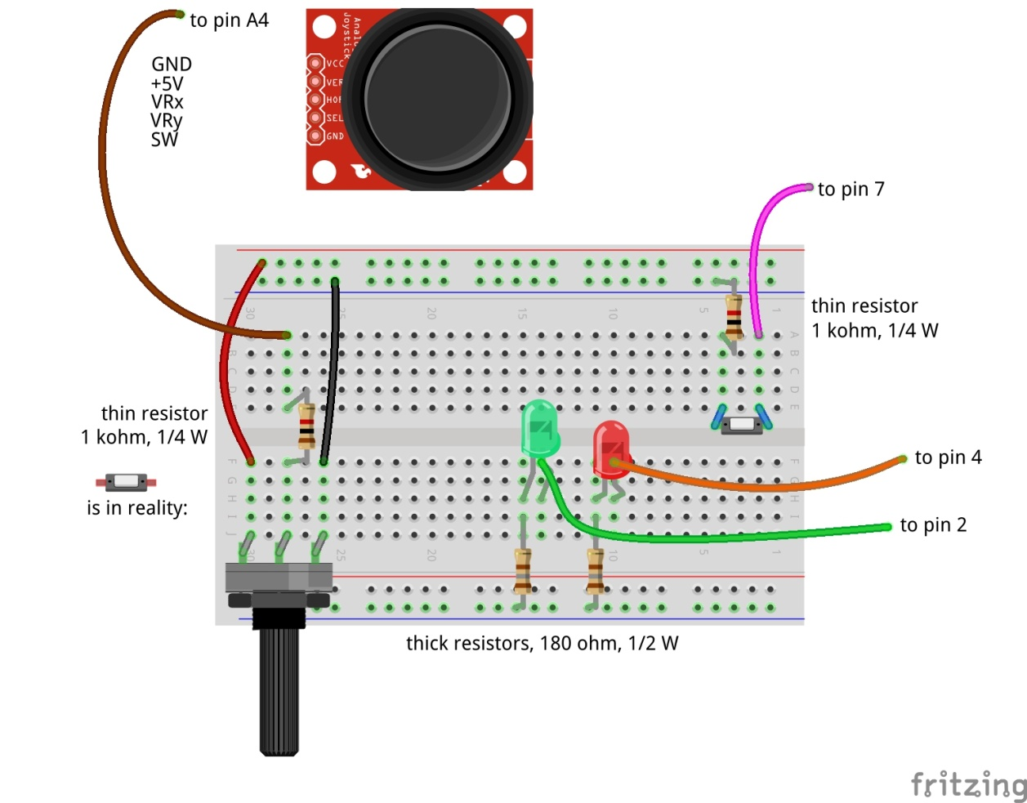
Adding analog input
Don’t forget: power off and USB cable out before making changes!

Slide 68
Update the config file
Update the config file again
Define Potmeter on pin A4 (direction: in, function: analog)
Now that you are updating anyway, already define for the next steps:
Define Servo1 on pin 12 (direction: out, function: servo)
Define BigBlueLED on pin 5 (direction: out, function: PWM)
Define Buzzer on pin 11 (direction: out, function: PWM)
Don’t forget to save

Slide 69
Test whether it works
Stop and restart scratchClient
Reconnect and repower the board
Make the sensor Potmeter visible
Turn the knob and see the values of Potmeter change
Between about 0 and about 1024
We will write some Scratch program to use it in the next step

Slide 70
Part 8: Pulse Width Modulation

Slide 71
Where we are …
We have seen:
Digital Input (the button) (in the beginners module)
Digital Output (the LEDs) (in the beginners module)
Analog Input (the potentiometer)
So what would be most logical next?
Analog Output? → but it does not exist!
However there is a good alternative: Pulse Width Modulation

Slide 72

Pulse Width Modulation (PWM)
By modulating (changing) the pulse width, the amount of energy fed to the e.g. LED is changed, and hence the intensity with which you see it lighting.
Note that in practice the LED is blinking some 800 blinks / second.
However, no human eye can see more than 100 blinks / second.

Slide 73
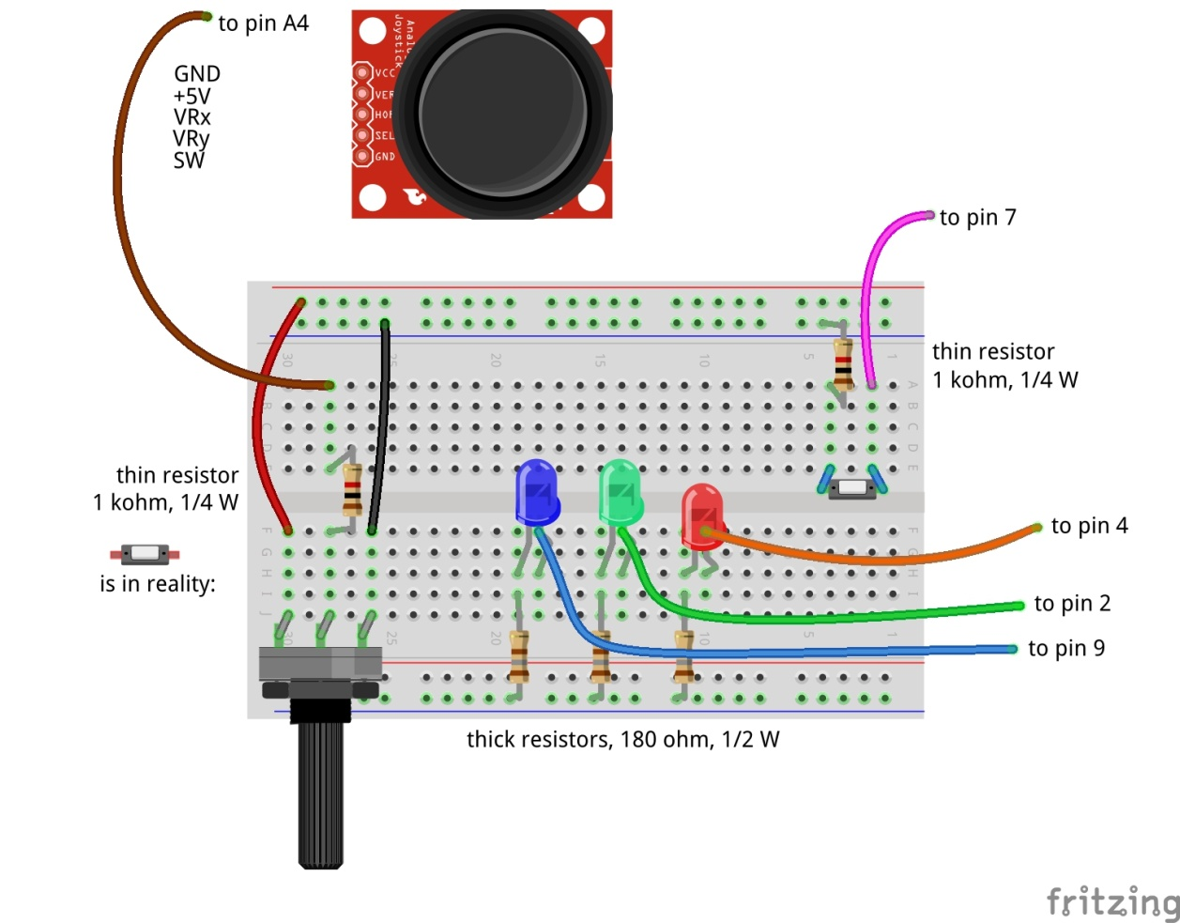
Dimming the BigBlueLED with PWM
Don’t forget: power off and USB cable out before making changes!

Slide 74
Test
Switch the power on again and reconnect
You will see that scratchClient finds the board again
You already updated the config file in the previous step, so no need to restart scratchClient
Define in Scratch a variable Big Blue LED
Make the variable visible
Give Big Blue LED values between 0 and 255
You can use the slider on the displayed variable for values between 0 and 100
For values above 100 we will use a program, see next slide
Does the LED brightness change?

Slide 75
Connect Potmeter and Big Blue LED (via Scratch)
Make some code that takes the potentiometer reading (between 0 and 1024) and transforms it into the range 0 to 255 (so divide by 4) and set the value of Big Blue LED.
Try out whether turning the potmeter changes the light intensity.
Notice that when turning to the right, the intensity goes down.
You would expect it to go up …
How can you very simply change this by interchanging two wires?

Slide 76
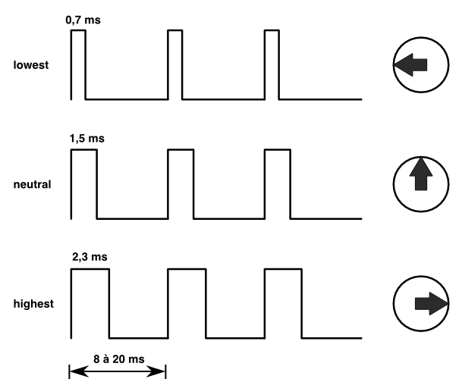
Controlling a servo with PWM
The position of the servo is changed by sending pulses of different width.
The servo looks at the pulsewidth and turns as desired.
The servo gets power separately.
With a servo, the pulse width modulation is not controlling the amount of energy fed to the servo
With a servo, pulse width modulation is rather a communication protocol.

Slide 77
Adding the servo to pin 12
Dark brown wire here
Don’t forget: power off and USB cable out before making changes!

Slide 78
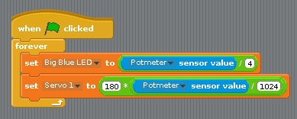
Testing the servo
Reconnect and repower the board
In Scratch, create a variable Servo1 and make it visible.
Try out giving it values between 0 and 100 via the slider on the variable.
The servo can handle values between 0 and 180
Does it move?
Update the loop where you set the Big Blue LED value dependent on the potmeter reading to now also set Servo 1.
But watch out: values have to be between 0 and 180.
To avoid overflow: first divide by 1024, then multiply by 180.
You may observe jitter.
Because the values of the potmeter will drift a bit and there will be power fluctuations, the reading of the potmeter will not be constant.
We will in the advanced workshop show how to deal with jitter

Slide 79
Controlling a buzzer with PWM
The buzzer will sound if it gets a signal in an audible frequency range.
A PWM signal on Arduino gives ca. 800 Hz.
Different for different pins
You will see that there is not much influence by changing the duty cycle.

Slide 80
Connect the buzzer to pin 11
Carefully watch the wires. Connect Vcc, GND and I/O correctly!
Don’t forget: power off and USB cable out before updating!

Slide 81
Testing the buzzer
No need to restart scratchClient, because the config file was not changed.
Define a variable Buzzer in Scratch
Give it values between 0 and 100
Using the slider on the variable
Does the value have much impact?
Add the setting of the buzzer to the loop where you already set the servo and the Big Blue LED.
Like with the LED, the values must be between 0 and 255.
Only test a short time (to save the ears of your neighbors ☺).

Slide 82
PWM limitations of Arduino (Nano and Uno)
General PWM is available on pins 3, 5, 6, 9, 10, 11
Servo can be configured on those pins, but also on 2, 4, 7, 8, 12
If a servo is configured on any pin, pins 9 and 10 cannot be configured as PWM anymore.
The config tool will warn you if you do it wrongly.

Slide 83
Part 9: Make a Scratch program
Extra material in case you have time left

Slide 84
Integrate with sprites
Load the following sprite
Big Red LED
Sits in the PiAndMore folder on the desktop in a folder Sprites.
Take a look at the code of the sprite.
Update the code that you wrote earlier today for the Big Red LED so that it sends messages to the sprite to turn the LED on and off

Slide 85
Add the Big Green LED sprite
Same that you did with the Big Red LED sprite, but now for the Big Green LED sprite.

Slide 86
Add the Big Blue LED sprite
Load the Big Blue LED sprite
Analyse the code in that sprite, which is different
The Big Blue LED sprite will move over the screen as the intensity changes
You can also move it with your mouse and see the intensity change.
Update your code that you wrote earlier to make use of the sprite.

Slide 87
Part 10: Take your work home

Slide 88
Do you want to take your work home?
If you brought your own USB stick, then connect it and copy the PiAndMore folder on the desktop
The rest of the material you can download from www.github.com
Take the flyer with you to remember where to find the material on github.

Slide 89
Part 11: Summary & take aways

Slide 90
Take aways of the beginners workshop
With scratchClient you define:
Function of each pin
Symbolic name for each configured pin
scratchClient config is the tool to setup the configuration
Restart scratchClient after you changed the configuration
Put a resistor in series with LEDs
Put a resistor in series with switches
Put a resistor in series with the middle contact of a potentiometer.
Configure a pull up resistor if the input signal goes between 0 Volt and being open rather than between 0 Volt and 3 to 5 Volt.
Output signals are controlled from Scratch by giving a variable a value
Input signals are monitored by the sensor programming elements
You can monitor the value of all pins from the browser
scratchClient can do much more…
Functions that a pin on Arduino can have:
Digital In
Digital Out
Analog In
No Analog Out
Pulse Width Modulation as alternative
For modulating the brightness of a LED
For controlling a servo
For controlling a buzzer
There a few more, see the advanced workshop
You can configure pull up resistors on Digital In

Slide 91
End of the intermediate workshop

Slide 92
If you want to know more …
Join the advanced workshop
Download the material and read the extensive documentation

Slide 93
Part 12: Clean up / teardown

Slide 94
If you continue to the Advanced Workshop …
You can continue to use your setup, with one exception:
You need to move the Big Blue LED to pin 9
Direction: out, function: output (so no PWM)
In the mean time you should know how to do this, otherwise please ask.

Slide 95
If your scratchClient day ends here …
Unplug the board from USB and power off the device
Please remove all components and wires from the breadboard
Remove all wires from the Arduino board.
Leave the wires on the 3 color LED (you did not use that)
Leave the wires on the buzzer
If something is broken, please
Throw it away or hand it in (if it is unclear)
Put a note in the box that it is missing
Do not put anything that is broken back in the box
Leave the Arduino running
Let us know what you thought about this workshop, now orally or later by email
hans.piam@hanselma.nl
heppg@web.de

Slide 96
More information
All workshop material
www.github.com and search for Weekendschool or for PiAndMore
scratchClient
http://heppg.de/ikg/wordpress/?page_id=6
Scratch
https://scratch.mit.edu/
Scratch on Raspberry Pi
https://www.raspberrypi.org/forums/viewforum.php?f=77
Raspberry Pi
https://www.raspberrypi.org/
Arduino
https://www.arduino.cc/

Slide 97
Physical computing from Scratch using scratchClient – Advanced Control servos, LEDs and more from Scratch using RPi, Arduino, scratchClient
Hans de Jong & Gerhard Hepp
Pi And More 10
Trier – 24 June 2017

Slide 98
Before we start

Slide 99
If you do not roll over from the beginners workshop …
If you are familiar with scratchClient, but not with the new config tool …
… you may want to look at some slides of the beginners workshop
Other than that, you do not have to build up the complete setup what the people of the beginners workshop did.
Only those things on the next slide.
You will however see the components of the beginners workshop in the diagrams.
Just ignore those.

Slide 100
Make a script file to start scratchClient
Then make a new file in the PiAndMore folder on the Desktop
Call it StartSC.bash
Put this into the file (copy/paste from this presentation):
!# /bin/bash
sudo python ~/scratchClient/src/scratchClient.py -c ~/Desktop/PiAndMore/PiAndMore.xml
pause –p “Press Enter to continue”
Make the file executable (file properties, permissions)
Do you understand what the file does?
If not, please ask
Only to be done if you did NOT continue from the beginners workshop

Slide 101
Connect the power wires
Only to be done if you did NOT continue from the beginners workshop

Slide 102
Make the config file for all steps
In order not to loose time, it is recommended to add all setups in the config file now.
If you continued from the beginners workshop then leave in what you have, only add.
D3: out, pwm, 3Color Red LED
D5: out, pwm, 3Color Blue LED
D6: out, pwm, 3Color Green LED
D8: in, counter_pullup, Counter button
D10: in, counter, IR sensor
- A0: in, analog, Rain Sensor
- A1: in, input_pullup, Tilt Sensor
- A2: out, output, Relay
- A3: in, analog, Sound Sensor
- A5: in, input_pullup, Joystick Button
- A6: in, analog, JoyStickY
- A7: in, analog, JoyStickX

Slide 103
Make variables
Save the config file
(Re)start scratchClient
In Scratch, create a variable for each of the out parameters.
Note: variable names are case sensitive.
In Scratch, make all of the sensors visible, so all in parameters.
Will only work if scratchClient successfully communicates to the board.

Slide 104
Choose the topics you want to give priority
The advanced workshop may be too short to do all activities.
So pick the order of the topics from the list
The red topics teach you more about scratchClient.
The green topics teach you more about electronics, sensors and engineering.
If you rather would do pieces of the beginners workshop then that is fine as well.
Joystick
Control position or control speed
Take care of calibration and drift
3-color LED
To make any color
Counter function
With button or IR slotted sensor
Rain sensor
Tilt sensor
Sound sensor
Strongly link the config file to the Arduino
For safety
For connection errors
Control multiple Arduinos concurrently
Power On Self Test
Controlling a relay
Controlling 220 Volt appliances (only info)
Controlling a camera (only info)

Slide 105
Joy stick

Slide 106
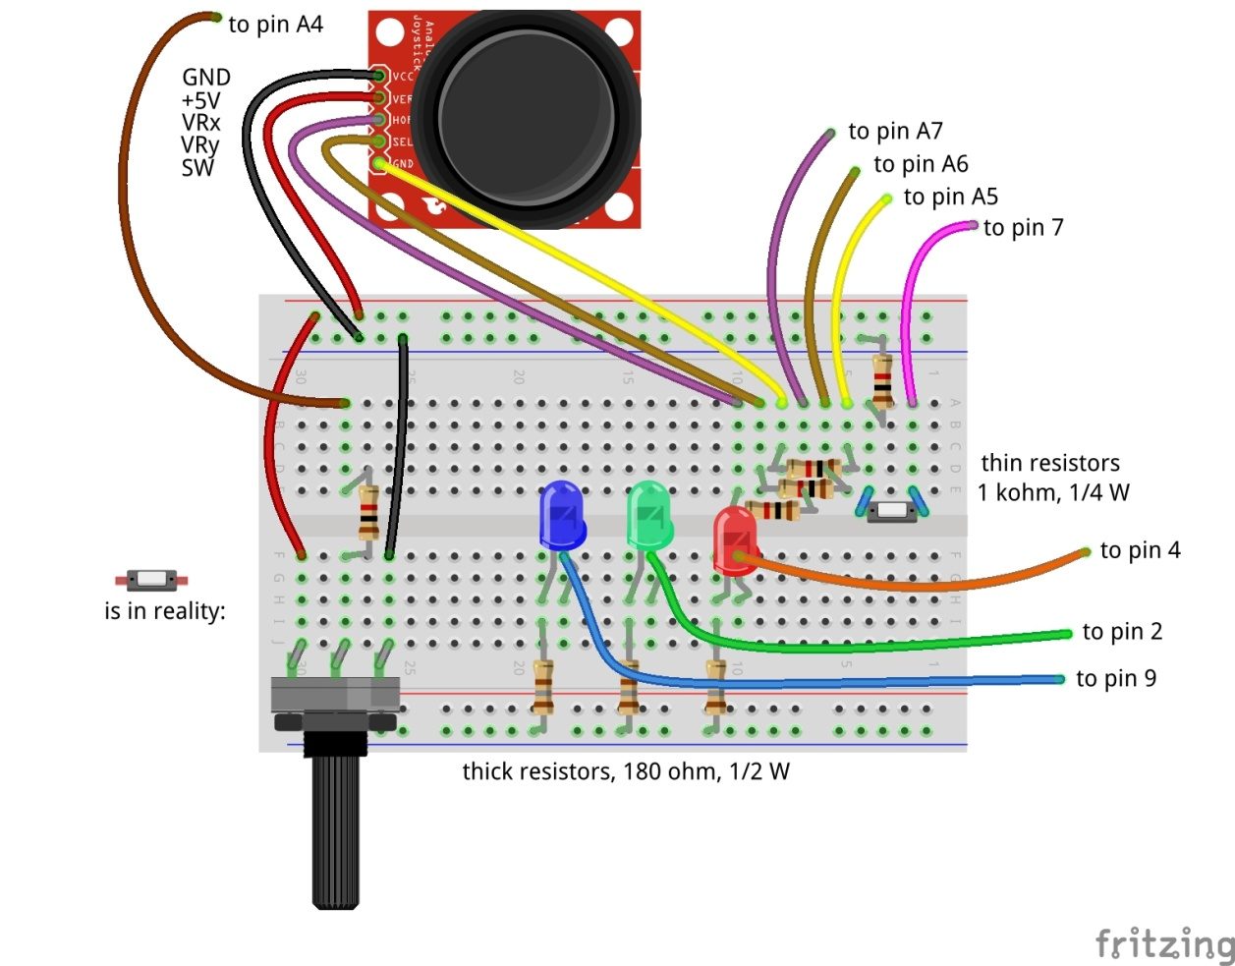
Adding the joy stick
X
Y
Don’t forget: power off and USB cable out before making changes!

Slide 107
Try it out
A joy stick has two small potentiometers and a button
When the joy stick is released (neutral position), the potentiometers are in the middle of the value range (middle between 0 and 1024)
There is one potentiometer for X and one for Y
The button is operated when pressing the button.
Reconnect and repower
Wait till the Arduino LED blinks slowly.
Now try moving and pressing the joy stick. Look at the 3 joy stick values to change
JoystickX and JoystickY between about 0 and about 1024.
Joystick Button between 0 and 1

Slide 108
Uses of Joysticks
You can directly use the value of the joystick
E.g. to control the position of a servo
E.g. to control the intensity of a LED
When releasing the knob, it will move back to the middle value.
E.g.: LED = JoystickX
You can alternatively use the joystick to determine the speed of the change
E.g. move a servo fast or slow. Let the servo stop at the latest position when you release the knob.
E.g.: LED = LED + (JoystickX – 512) / 200 (512 = neutral position value, 200 = sensitivity)
You can also use the Scratch pen function draw on the screen.
And e.g. use the potentiometer to change pen width or color.
Take care of drift and jitter (see next slide)

Slide 109
Take care of drift and jitter
Not all joysticks will give the same value if they are in the middle position
Influenced by temperature, the value produced in the middle position can drift over time.
Therefore build in some threshold around the middle position
If the middle position is 512, then do only react if the value changes by at least ca. 15, so e.g. > 525 or < 500.
Whether 15 is enough as threshold you will learn over time. Increase the value if it drifts more than that.
If you have a general program that works with several joysticks then you may have to use a larger threshold, or you need to calibrate (adapt the program for each particular servo).

Slide 110
Control a 3-color LED
To make all colors

Slide 111
Control a 3-color LED
Don’t forget: power off and USB cable out before making changes!
A 3-color LED has 3 LEDs in one package
Green
Red
Blue
Use PWM to change the intensity of each color
In that way you can create the entire spectrum of light
Including white light
Connect the 3-color LED carefully to the pins as defined in the config file.
Also connect the minus (–) pin to GND
Reconnect and repower
No need to restart scratchClient (since no update to the config file was made)
Give the corresponding variables in Scratch values between 0 and 100 with the slider on the variable.
Does it work?
We will see in the next slide how to use values between 0 and 255

Slide 112
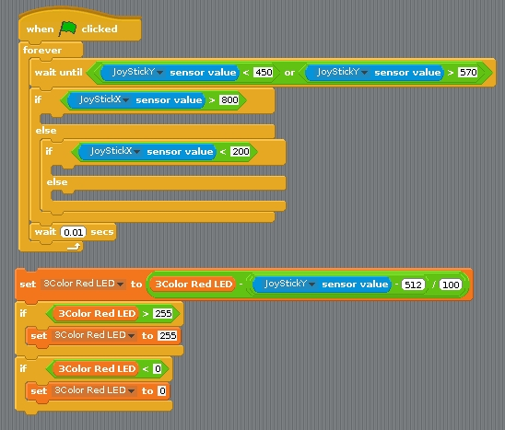
Connecting the 3-color LED to the joy stick (via Scratch)
Write a program in Scratch that:
Uses the value of the X direction of the joy stick to determine red, green or blue
Uses the value of the Y direction to change the intensity of the respective LED
When releasing the joy stick, the colors should stay
You will need these elements
You need this block 3 times for the 3 colors

Slide 113
The new counting function

Slide 114
Why a special counting function?
You can count in Scratch, however you can only reliably count a few pulses per second.
With this new counting function, you can do it much faster
If you need to detect small pulses that scratchClient may not see reliable, you can use a counter function to detect whether a (short) pulse did arrive.

Slide 115
Counter function using a button
It will count up. It will wrap round at a very large value that will be reached after days of counting.
Max. ca. 80 counts per second = 4800 per minute
There is a 4 ms debouncing delay
So multiple pulses within 4 ms will processed as a single count
So no need for capacitors to do debouncing

Slide 116
Debouncing
If a mechanical switch is operated, it can generate a series of pulses rather than one.
This is because one of the metal pieces bounces back a few times before it stays in position.
You would normally need take care of this if you want to get a single pulse
E.g. add a capacitor.
scratchClient will on the digital input pins only sample with 10 Hz, so it is unlikely that you will experience bounce problems.

Slide 117
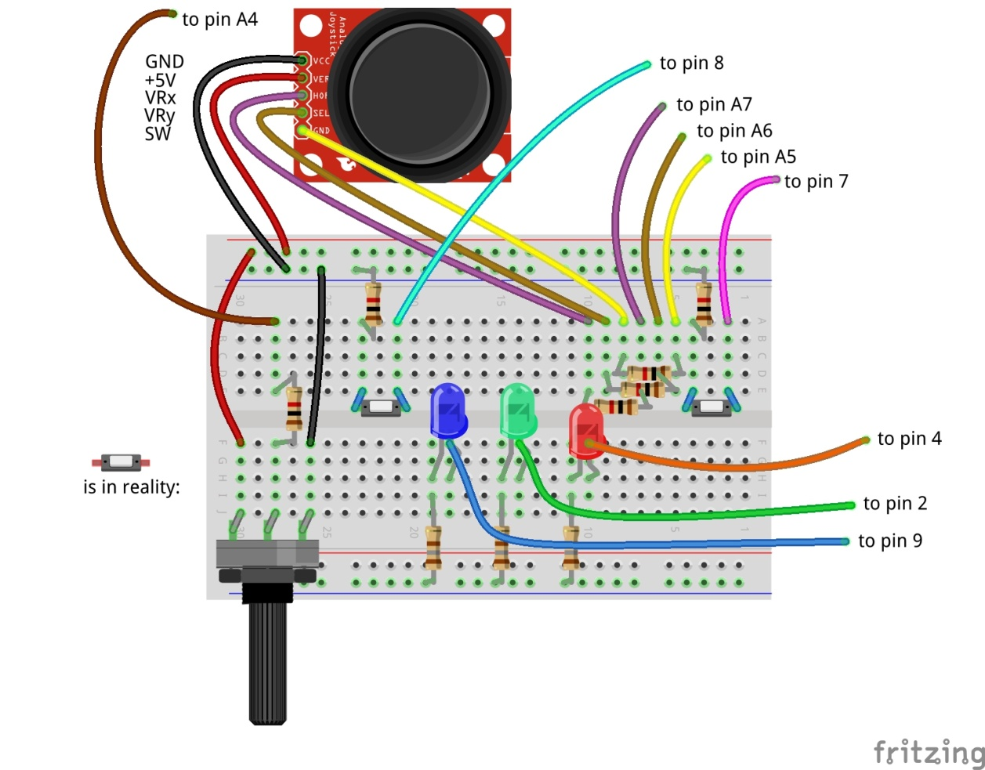
Adding the count button
Don’t forget: power off and USB cable out before making changes!

Slide 118
Adding an IR speed sensor that counts on pin 10
Carefully follow the wires to connect correctly!
Don’t forget: power off and USB cable out before making changes!

Slide 119
Differences between the counters
The IR sensor gives an output of 0 Volt or 5 Volt.
Therefore it does not need a pull up resistor (see the config file)
The button gives an output of 0 Volt or open.
Hence it needs a pull up resistor (as specified in the config file)

Slide 120
Try out the setup
The button you can just press.
The IR sensor you need to have good opaque material to let it work.
You can check the sensing by the LED at the backside.

Slide 121
Tilt sensor

Slide 122
Tilt sensor
The tilt sensor is a sensor containing a rolling ball between contacts.
You can hear it rattling if you shake it.
It is not in the box. We only have a few, so you will need to share.

Slide 123
Connect the tilt sensor to pin A1
Carefully follow the wires to connect correctly!
Don’t forget: power off and USB cable out before making changes!

Slide 124
Rain Sensor

Slide 125
Rain sensor
A rain sensor is an analog sensor that measures conductivity that is influenced by water.
It is not in the box. We only have a few, so you will need to share.

Slide 126
Connect the rain sensor to pin A0
Carefully follow the wires to connect correctly!
Don’t forget: power off and USB cable out before making changes!

Slide 127
Sound sensor

Slide 128
Sound Sensor
The sound sensor will detect sound.
It is a digital sensor that contains a microphone and will give 0 Volt if sound is detected, 5 Volt if no sound detected.
It is not in the box. We only have a few, so you will need to share.

Slide 129
Connect the sound sensor to pin A3
Carefully follow the wires to connect correctly!
Don’t forget: power off and USB cable out before making changes!

Slide 130
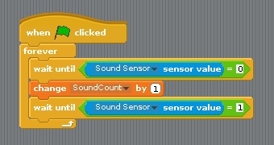
See the short pulses
The changes of the sound sensor are sometimes difficult to see just from the displayed sensor value
This code can be used to see that the sensor is actually working. You must create a variable SoundCount (or choose a different name) to hold the count.

Slide 131
Strongly link the config file to the Arduino

Slide 132
The ident functionality
You created a board, but maybe you have omitted some resistors and therefore damage would occur if it were used with the wrong config file.
That is what the ident functionality is for
Configure an identity in the Arduino
Specify the identity in the config file

Slide 133
Programming the ident in the Arduino
Have the Arduino connected
Start the Arduino IDE
Go to monitor mode
Set the speed to 115200
Set the line end to newline
You can now type commands in the window.
Type:
cident:PiAndMore10
cident? (you should get the string back)
Put in the config tool the value PiAndMore10 in the field Parameter ident.pattern

Slide 134
Testing ident functionality
Start scratchClient and see that it works
Now change the value of the ident in the config file.
Hardly matters what
Start scratchClient again and see that it will be rejected

Slide 135
More about ident
The ident can in the config file be specified as a regular expression. E.g.:
A dot (.) matches any character
A star (*) repeats the previous character (0 or more times)
If you want to know more about regular expressions, see e.g. http://www.rexegg.com/regex-quickstart.html
So you could specify
PiAndMore.* and it would work when PiAndMore9, PiAndMore10 or PiAndMore100 is programmed in the ident of the Arduino
Ident is also needed to identify a specific Arduino if multiple will be connected concurrently (see next slides).

Slide 136
Controlling multiple Arduinos

Slide 137
Control multiple Arduinos
Running out of pins on one Arduino? Connect more of them!
The /dev/ttyUSBnn port in the config file will define which part of the configuration is used for which Arduino.
Using the ident functionality (see previous topic) can be used to check that the correct Arduino was connected to the intended port.
You can get the Arduinos on the correct ports by connecting them always in the same sequence.

Slide 138
Creating a config file for multiple Arduinos
First create two separate config files for each Arduino and test them out.
The config tool can only work on a single adapter at a time.
Now create a new .xml file, and
Copy in the first file completely
Take the adapter section (most of the file) of the second file and paste this after the first adapter
Adapt the USB port in one of the files (make the board that you connect last /dev/ttyUSB1.

Slide 139
Trying it out – merge and config
Take the Weekendschool board with the Duck
Test it out with the config file and the Scratch program
Merge the two files in the way described.
Make the Weekendschool board /dev/ttyUSB1.
Disconnect both boards.
Restart scratchClient with the merged file.
Connect the workshop board first. It will become /dev/ttyUSB0.
Connect the Weekendschool board second. It will become /dev/ttyUSB1.

Slide 140
Trying it out – Control from Scratch
In the Scratch program of the workshop, define these variables
Tiltservo
Panservo
Try giving them values between 0 and 100 with the slider on the variable.
Does the duck tilt and pan?

Slide 141
Making the /dev/ttyUSBnn not matter anymore
In the way described before, the Arduinos must be connected in a specific sequence
You can alternatively use a program that will
Look at the connected boards (using the ident string)
Give a selection option to start with config files for which all the boards are present.

Slide 142
Explaining the startup tool

Slide 143
Power on self test (POST)

Slide 144
Power on self test (POST)
See the Weekendschool board with the duck.
When setting up the lesson, one wants to be able to quickly see whether the board works correctly.
Also, when the boards have to be packed, the duck should bow deep to make sure it fits in the box.
Moving servos by hand is not preferred.
The scratchClient Arduino sketch has a place where you can insert your own code to realise this functionality.

Slide 145
How to do the POST?
You will need to address the pin numbers directly. You cannot make use of the config file of scratchClient.
See the Arduino sketch of the Weekendschool board.
Between the xxxx and yyyy markers
Now try on the PiAndMore board to lite 3-color LED
0.5 seconds Red
0.5 seconds Green
0.5 seconds Blue
0.5 seconds White
Load the sketch in the board and look whether it works.

Slide 146
Controlling a relay

Slide 147
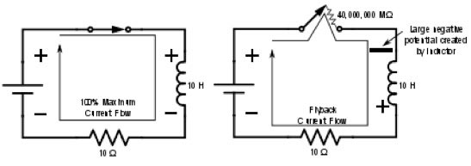
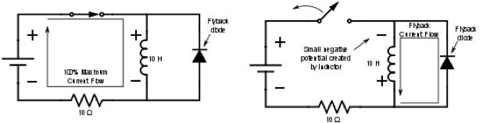
Controlling a relay
Controlling a relay like controlling a LED? NOT a good idea!
A relay has a coil that stores energy when powered.
When breaking the current flow, the voltage over the relay coil can get so high that it destroys the Arduino – and more.
At least a flyback diode should be used.

Slide 148
Other issues – and the solution
Often the current of the coil will be too high to drive directly from the Arduino
So a transistor will be needed.
Solution
Use a relay module with an opto coupler
Cost is generally not an issue. The relay module we use here is < € 1.
We only have a few relays today, so you will need to share.

Slide 149
Connect the relay module to pin A2
Carefully follow the wires to connect correctly!
Don’t forget: power off and USB cable out before making changes!

Slide 150
Use a servo to press buttons on appliances

Slide 151
Safely controlling 220 Volt appliances
You can in principle use a relay to control 220 Volt appliances.
However, this is not something you want to do in a classroom situation
Alternative: use a remote control and use servos to press the buttons.
See also the next slide.

Slide 152
Controlling a camera
Use a servo to press the button of the camera
Cannot do in the workshop
See the example setup in the workshop

Slide 153
What else can scratchClient do?

Slide 154
Can scratchClient do more? Yes!
It can also let you configure and use the GPIO pins on the Raspberry Pi itself.
However be aware:
There is no analog input on Raspberry Pi.
The pins are NOT 5 Volt tolerant (max 3.3 Volt).
The max current per pin on Raspberry Pi is lower than on Arduino.
If you blow up an Arduino (clone), the cost is limited to a few euro.
A Raspberry Pi is much more expensive.
scratchClient can also control Sonic Pi for high quality audio.
There are also Arduino sketches to control LED strips (Neopixel WS2812) and to control LEGO Power.
scratchClient can work with Scratch 2.0 (soon).
scratchClient can also run on Windows and then via Arduino control peripherals.
scratchClient can work with multiple Raspberry Pi configurations in a network.

Slide 155
Take your work home

Slide 156
Do you want to take your work home?
If you brought your own USB stick, then connect it and copy the PiAndMore folder on the desktop
The rest of the material you can download from www.github.com
Take the flyer with you to remember where to find the material on github.

Slide 157
Clean up / teardown

Slide 158
Unplug and pack up
Unplug the board from USB and power it off
Please remove all components and wires from the breadboard
Remove all wires from the Arduino board.
Leave the wires on the 3 color LED
Leave the wires on the buzzer
If something is broken, please
Throw it away or hand it in (if it is unclear)
Put a note in the box that it is missing
Do not put anything that is broken back in the box
Put everything in the box. The board goes on top
Shutdown the Arduino
Let us know what you thought about this workshop, now orally or later by email
hans.piam@hanselma.nl
heppg@web.de

Slide 159
More information
All workshop material
www.github.com and search for Weekendschool or for PiAndMore
scratchClient
http://heppg.de/ikg/wordpress/?page_id=6
Scratch
https://scratch.mit.edu/
Scratch on Raspberry Pi
https://www.raspberrypi.org/forums/viewforum.php?f=77
Raspberry Pi
https://www.raspberrypi.org/
Arduino
https://www.arduino.cc/

Slide 160
End of the Advanced Workshop

Slide 161
Appendix

Slide 162
Maximum current per pin
Max output current per pin = 20 mA
Total current for the board: 1 A
Note that also the potentiometer and the joystick take power

Slide 163
Calculation of the resistors

Slide 164
Cost of the setup (1 of 2)
This is a list of the cost of the setup of the external board.
Not included is the cost of the perspex board and the nuts and bolts, which are not an absolute minimum requirement
And for which there are alternatives, e.g. use cardboard or an MDF board
All material comes from Aliexpress
Very cheap
Often no shipping costs to Europe
Takes between 2 weeks and 2 months
Or never arrives, but then money is promptly returned.
When ordering below 22 euro, no import duties and handling costs

Slide 165
Cost of the setup (2 of 2)

Slide 166
The End

